Slide 1
Mixed Effects
Define Mixed effects
Give overview of conditional distributions

Slide 2
Fixed Effect or Random Effect?
Whether an effect is classified as fixed or random depends
on how the factor levels were selected (were they randomly chosen?)
the objectives of the experiment (are you interested in testing that effect?)
Example: We are running an agricultural experiment on crop yield. Let’s consider two related scenarios:
We have a group of farmers that paid for statistical consulting for optimizing their farms’ yields
We sample from a group of farmers and we run an experiment using the selected farms’ yields as the response
We would block by farm in both cases
But in 1. the block is of direct interest while in 2. it’s used to control for confounding

Slide 3
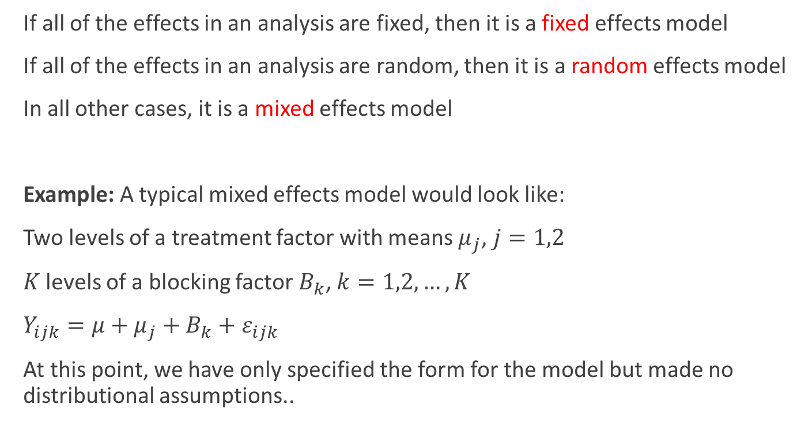
Some Definitions
If all of the effects in an analysis are fixed, then it is a fixed effects model
If all of the effects in an analysis are random, then it is a random effects model
In all other cases, it is a mixed effects model
Example: A typical mixed effects model would look like:
Two levels of a treatment factor with means $μ_{j}$, $j=1,2$
$K$ levels of a blocking factor $B_{k}$, $k=1,2,…,K$
$Y_{ijk}=μ+μ_{j}+B_{k}+ε_{ijk}$
At this point, we have only specified the form for the model but made no distributional assumptions..

Slide 4
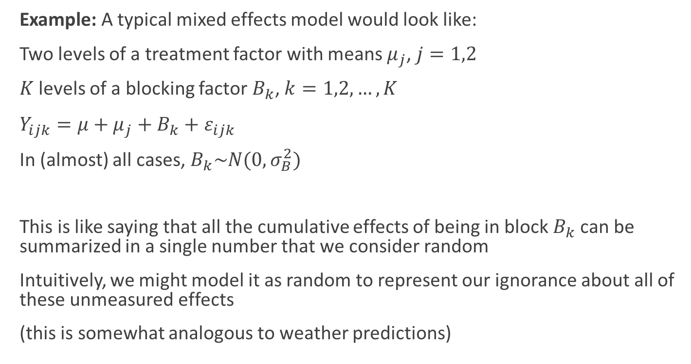
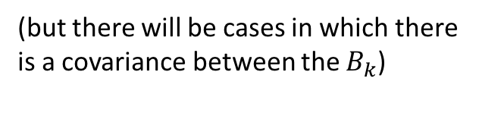
Adding Distributional Assumptions
Example: A typical mixed effects model would look like:
Two levels of a treatment factor with means $μ_{j}$, $j=1,2$
$K$ levels of a blocking factor $B_{k}$, $k=1,2,…,K$
$Y_{ijk}=μ+μ_{j}+B_{k}+ε_{ijk}$
In (almost) all cases, $B_{k}\sim N(0,σ_{B}^{2})$
This is like saying that all the cumulative effects of being in block $B_{k}$ can be summarized in a single number that we consider random
Intuitively, we might model it as random to represent our ignorance about all of these unmeasured effects
(this is somewhat analogous to weather predictions)
(but there will be cases in which there is a covariance between the $B_{k}$)

Slide 5
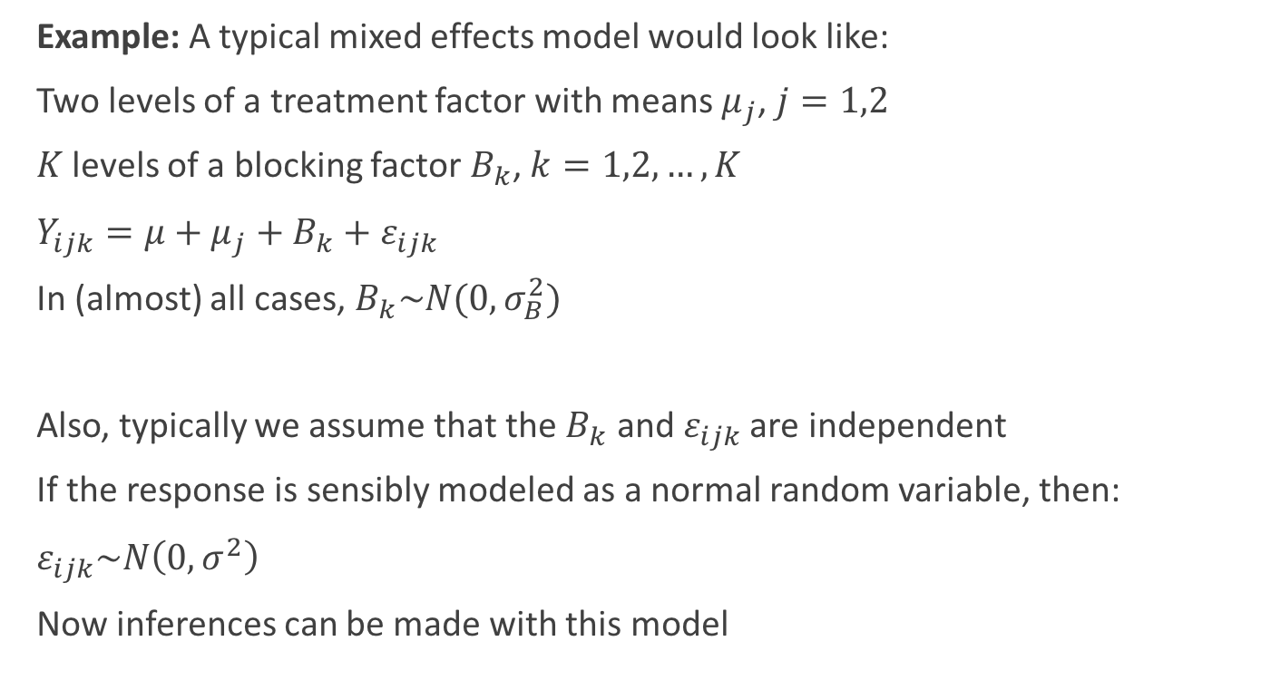
Adding Distributional Assumptions
Example: A typical mixed effects model would look like:
Two levels of a treatment factor with means $μ_{j}$, $j=1,2$
$K$ levels of a blocking factor $B_{k}$, $k=1,2,…,K$
$Y_{ijk}=μ+μ_{j}+B_{k}+ε_{ijk}$
In (almost) all cases, $B_{k}\sim N(0,σ_{B}^{2})$
Also, typically we assume that the $B_{k}$ and $ε_{ijk}$ are independent
If the response is sensibly modeled as a normal random variable, then:
$ε_{ijk}\sim N\left(0,σ^{2}\right)$
Now inferences can be made with this model

Slide 6
Conditional Distributions

Slide 7
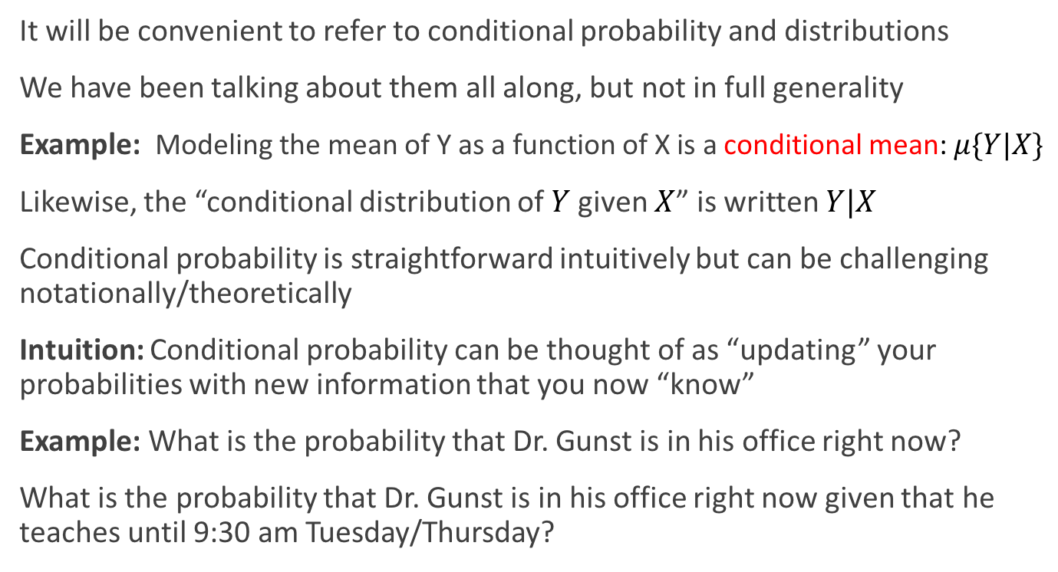
Conditional Distributions
It will be convenient to refer to conditional probability and distributions
We have been talking about them all along, but not in full generality
Example: Modeling the mean of Y as a function of X is a conditional mean: $μ\{Y|X\}$
Likewise, the “conditional distribution of $Y$ given $X$” is written $Y|X$
Conditional probability is straightforward intuitively but can be challenging notationally/theoretically
Intuition: Conditional probability can be thought of as “updating” your probabilities with new information that you now “know”
Example: What is the probability that Dr. Gunst is in his office right now?
What is the probability that Dr. Gunst is in his office right now given that he teaches until 9:30 am Tuesday/Thursday?

Slide 8
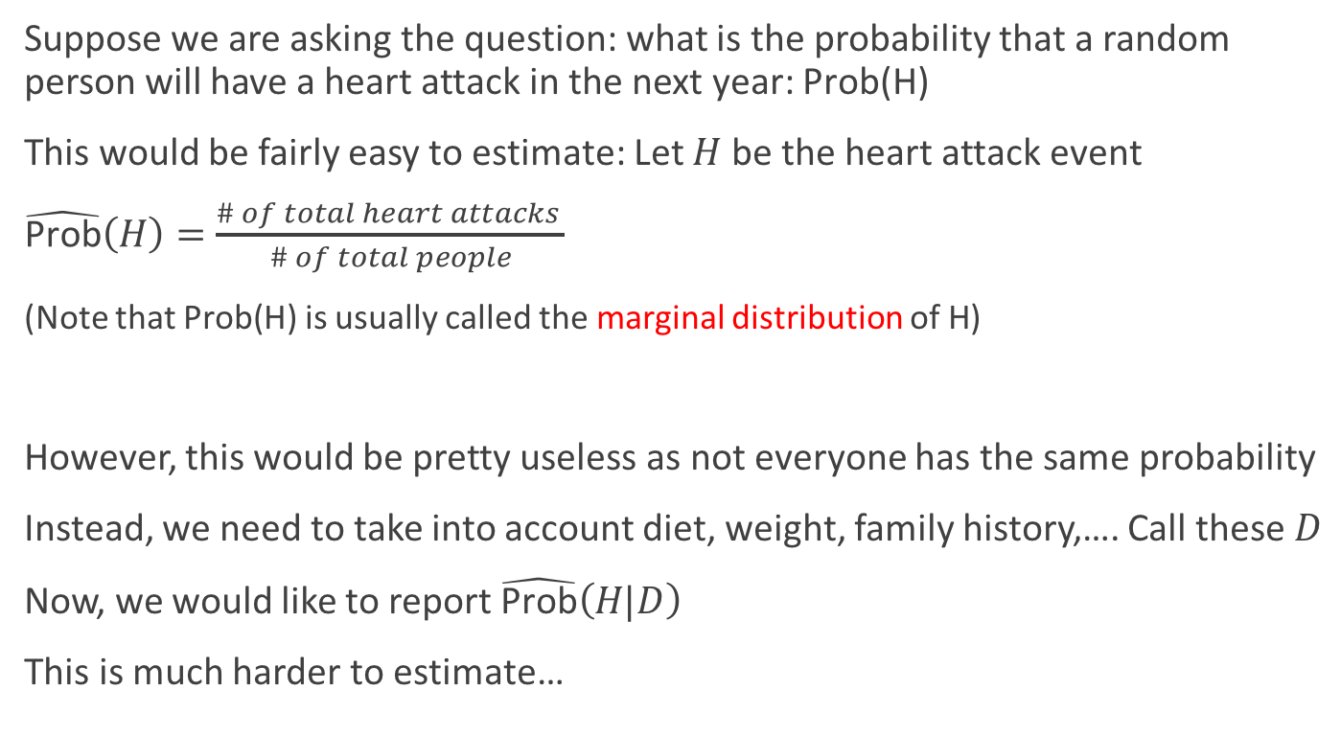
Conditional Distributions
Suppose we are asking the question: what is the probability that a random person will have a heart attack in the next year: $\text{Prob}\text{(}\text{H}\text{)}$
This would be fairly easy to estimate: Let $H$ be the heart attack event
$\hat{\text{Prob}}\left(H\right)=\frac{\# of total heart attacks }{\# of total people}$
(Note that $\text{Prob}\text{(}\text{H}\text{)}$ is usually called the marginal distribution of $\text{H}$)
However, this would be pretty useless as not everyone has the same probability
Instead, we need to take into account diet, weight, family history,…. Call these $D$
Now, we would like to report $\hat{\text{Prob}}\left(H|D\right)$
This is much harder to estimate…

Slide 9
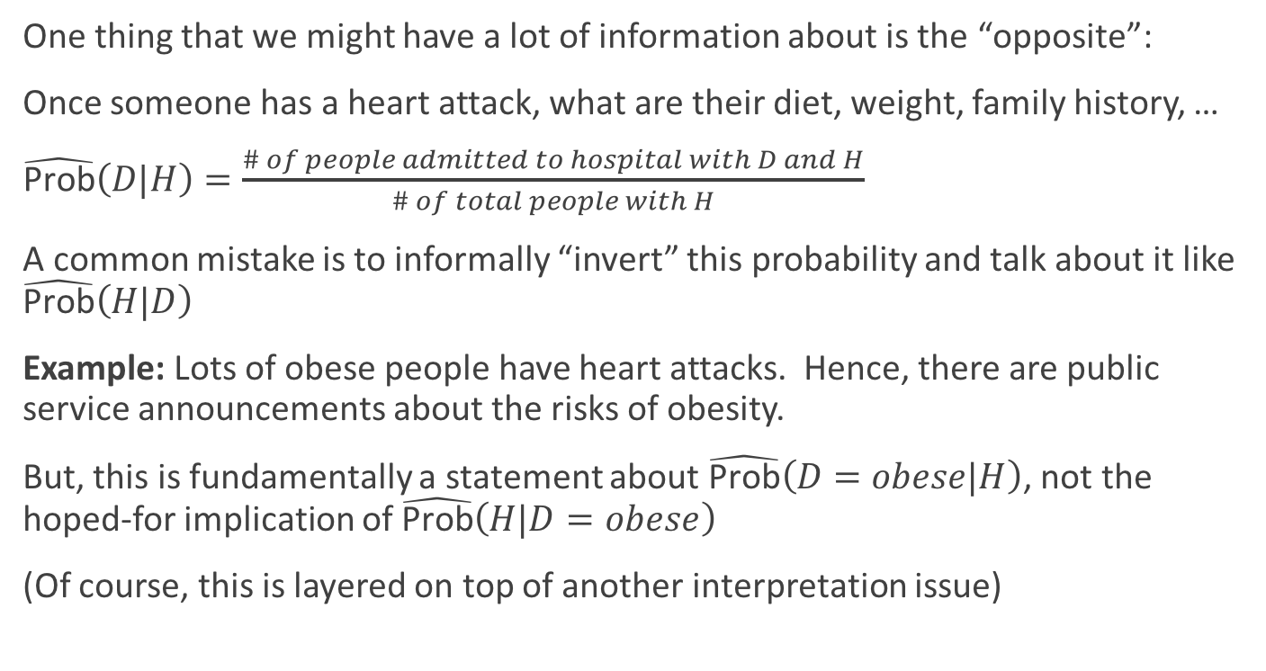
Conditional Distributions
One thing that we might have a lot of information about is the “opposite”:
Once someone has a heart attack, what are their diet, weight, family history, …
$\hat{\text{Prob}}\left(D|H\right)=\frac{\# of people admitted to hospital with D and H}{\# of total people with H}$
A common mistake is to informally “invert” this probability and talk about it like $\hat{\text{Prob}}\left(H|D\right)$
Example: Lots of obese people have heart attacks. Hence, there are public service announcements about the risks of obesity.
But, this is fundamentally a statement about $\hat{\text{Prob}}\left(D=obese|H\right)$, not the hoped-for implication of $\hat{\text{Prob}}\left(H|D=obese\right)$
(Of course, this is layered on top of another interpretation issue)

Slide 10
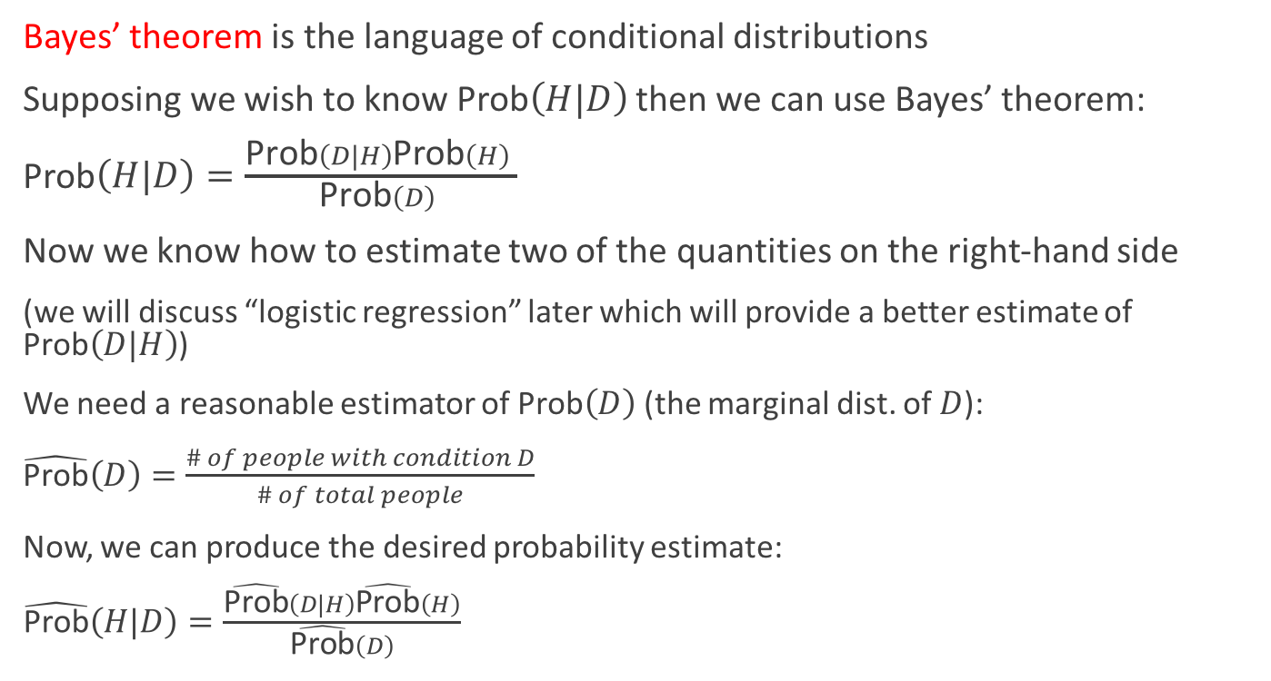
Conditional Distributions
Bayes’ theorem is the language of conditional distributions
Supposing we wish to know Prob$\left(H|D\right)$ then we can use Bayes’ theorem:
Prob$\left(H|D\right)=\frac{\text{P}\text{rob}\left(D|H\right)\text{Prob}\left(H\right) }{\text{Prob}\left(D\right) }$
Now we know how to estimate two of the quantities on the right-hand side
(we will discuss “logistic regression” later which will provide a better estimate of $\text{Prob}\left(D|H\right)$)
We need a reasonable estimator of $\text{Prob}\left(D\right)$ (the marginal dist. of $D$):
$\hat{\text{Prob}}\left(D\right)=\frac{\# of people with condition D}{\# of total people}$
Now, we can produce the desired probability estimate:
$\hat{\text{Prob}}\left(H|D\right)=\frac{\hat{\text{Prob}}\left(D|H\right)\hat{\text{Prob}}\left(H\right)}{\hat{\text{Prob}}\left(D\right)}$

Slide 11
Mixed Effects Models

Slide 12
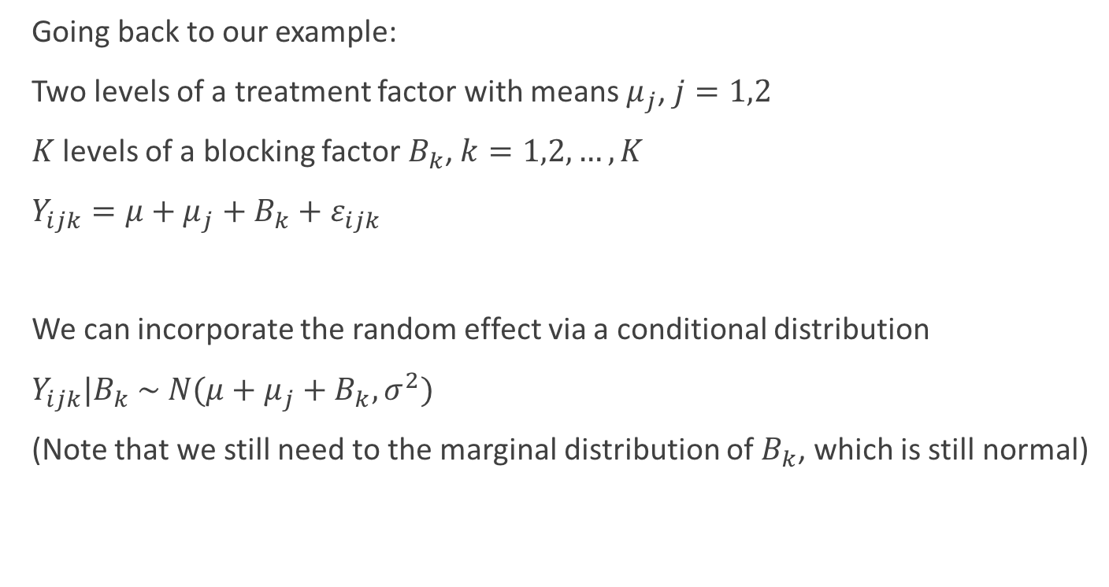
Mixed Effects as a Conditional Distribution
Going back to our example:
Two levels of a treatment factor with means $μ_{j}$, $j=1,2$
$K$ levels of a blocking factor $B_{k}$, $k=1,2,…,K$
$Y_{ijk}=μ+μ_{j}+B_{k}+ε_{ijk}$
We can incorporate the random effect via a conditional distribution
$Y_{ijk}|B_{k} \sim N({μ+μ_{j}+B}_{k},σ^{2})$
(Note that we still need to the marginal distribution of $B_{k}$, which is still normal)

Slide 13
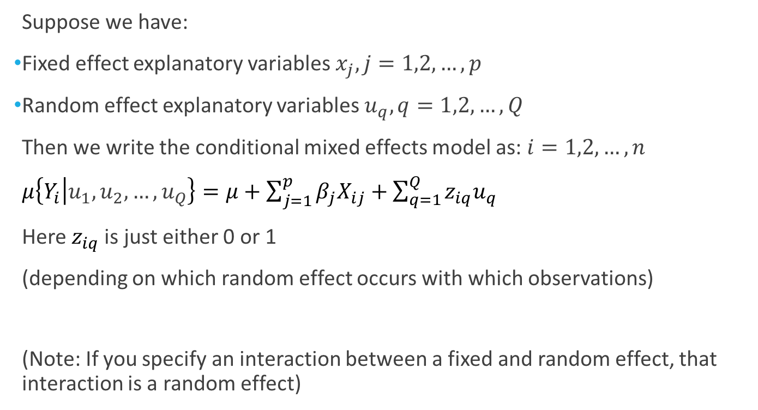
Linear Mixed Effects Model
Suppose we have:
Fixed effect explanatory variables $x_{j}, j=1,2,…,p$
Random effect explanatory variables $u_{q}, q=1,2,…,Q$
Then we write the conditional mixed effects model as: $i=1,2,…,n$
$μ\left\{Y_{i} | u_{1},u_{2},…,u_{Q}\right\}=μ+\sum_{j=1}^{p}{β_{j}X_{ij}}+\sum_{q=1}^{Q}{z_{iq}u_{q}}$
Here $z_{iq}$ is just either 0 or 1
(depending on which random effect occurs with which observations)
(Note: If you specify an interaction between a fixed and random effect, that interaction is a random effect)

Slide 14
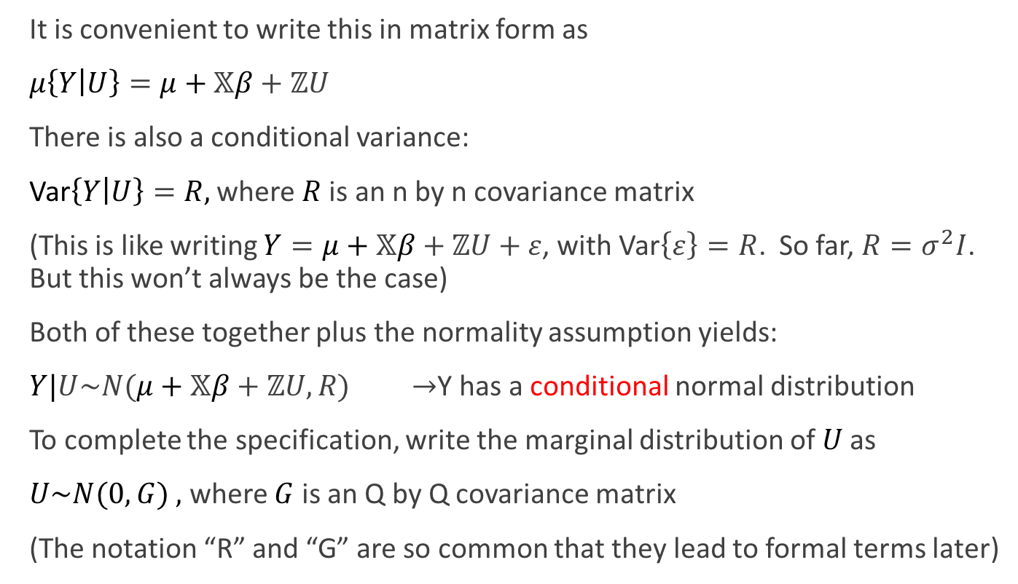
Linear Mixed Effects Model
It is convenient to write this in matrix form as
$μ\left\{Y | U\right\}=μ+𝕏β+ℤU$
There is also a conditional variance:
Var$\left\{Y | U\right\}=R,$ where $R$ is an n by n covariance matrix
(This is like writing $Y=μ+𝕏β+ℤU+ε$, with Var$\left\{ε\right\}=R$. So far, $R=σ^{2}I$. But this won’t always be the case)
Both of these together plus the normality assumption yields:
$Y|U\sim N(μ+𝕏β+ℤU,R)$ $→$Y has a conditional normal distribution
To complete the specification, write the marginal distribution of $U$ as
$U\sim N(0,G)$ $,$ where $G$ is an Q by Q covariance matrix
(The notation “R” and “G” are so common that they lead to formal terms later)

Slide 15
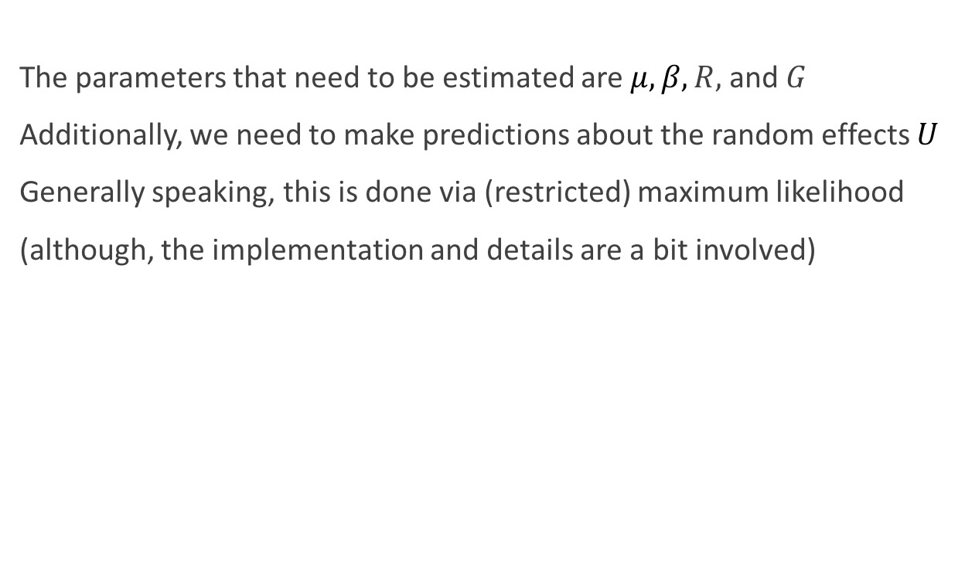
Linear Mixed Effects Model: Estimation
The parameters that need to be estimated are$μ,β,R,$ and $G$
Additionally, we need to make predictions about the random effects $U$
Generally speaking, this is done via (restricted) maximum likelihood
(although, the implementation and details are a bit involved)

Slide 16
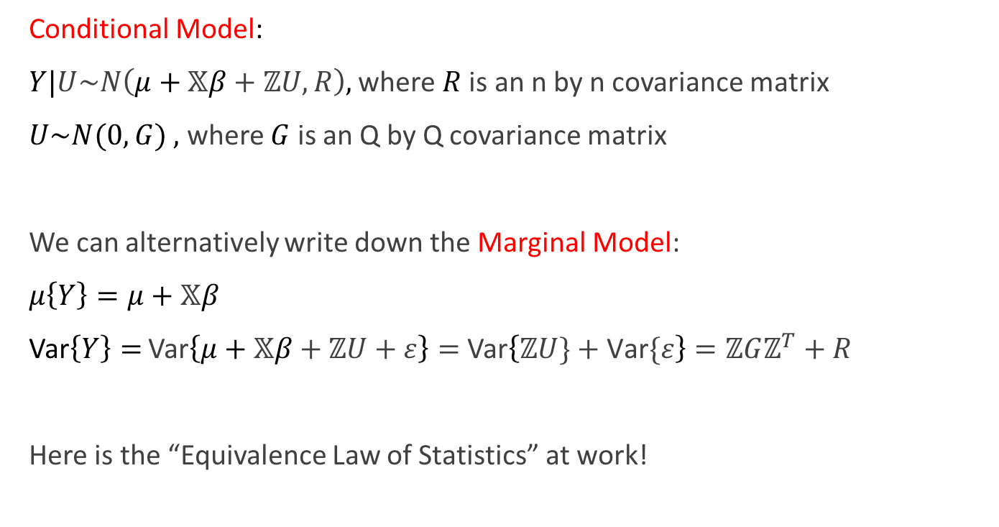
Linear Mixed Effects Model: Conditional vs. Marginal
Conditional Model:
$Y|U\sim N\left(μ+𝕏β+ℤU,R\right),$ where $R$ is an n by n covariance matrix
$U\sim N(0,G)$ $,$ where $G$ is an Q by Q covariance matrix
We can alternatively write down the Marginal Model:
$μ\left\{Y\right\}=μ+𝕏β$
Var$\left\{Y\right\}=$ Var$\left\{μ+𝕏β+ℤU+ε\right\}=$ Var$\left\{ℤU\}+\text{Var}\{ε\right\}=ℤGℤ^{T}+R$
Here is the “Equivalence Law of Statistics” at work!
(Some mean term has been converted to variance/covariance)

Slide 17
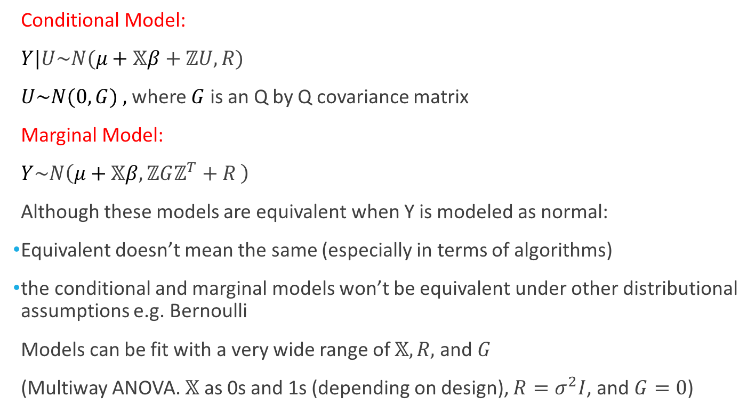
Linear Mixed Effects Model: Conditional vs. Marginal
Conditional Model:
$Y|U\sim N(μ+𝕏β+ℤU,R)$
$U\sim N(0,G)$ $,$ where $G$ is an Q by Q covariance matrix
Marginal Model:
$Y\sim N\left(μ+𝕏β,ℤGℤ^{T}+R \right)$
Although these models are equivalent when Y is modeled as normal:
Equivalent doesn’t mean the same (especially in terms of algorithms)
the conditional and marginal models won’t be equivalent under other distributional assumptions e.g. Bernoulli
Models can be fit with a very wide range of $𝕏,R,$ and $G$
(Multiway ANOVA. $𝕏$ as 0s and 1s (depending on design), $R=σ^{2}I$, and $G=0$)

Slide 18
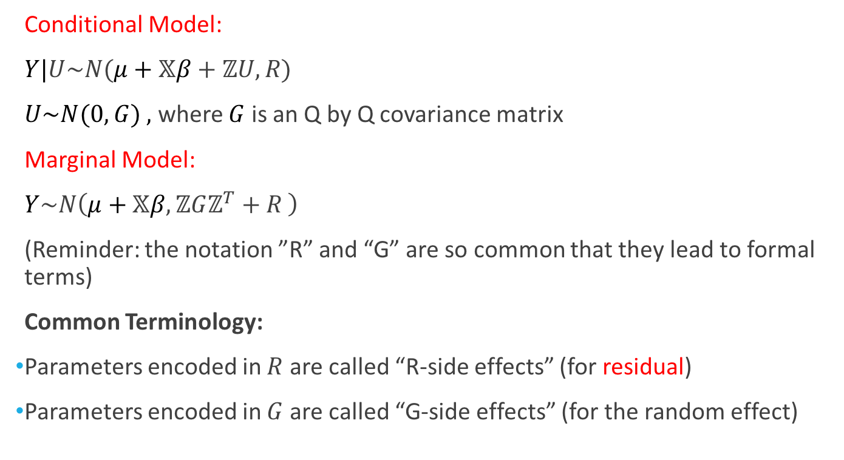
Linear Mixed Effects Model: Conditional vs. Marginal
Conditional Model:
$Y|U\sim N(μ+𝕏β+ℤU,R)$
$U\sim N(0,G)$ $,$ where $G$ is an Q by Q covariance matrix
Marginal Model:
$Y\sim N\left(μ+𝕏β,ℤGℤ^{T}+R \right)$
(Reminder: the notation ”R” and “G” are so common that they lead to formal terms)
Common Terminology:
Parameters encoded in $R$ are called “R-side effects” (for residual)
Parameters encoded in $G$ are called “G-side effects” (for the random effect)
Note that the marginal model specification won’t have G-side effects

Slide 19
Mixed Effects Models: Example

Slide 20
An Agricultural Experiment
Suppose we are testing the effectiveness of two cultivars of a crop at a large, commercial farm
The farm is naturally divided into a large number of pairs of plots, so we decide to create a blocking factor that contains two plots
These plots will be the experimental unit with respect to the treatment
We choose to model the blocking variable as random due to:
As the farm contains many such pairs of plots, we subsample from them randomly (Let’s choose 10 pairs of plots)
We are not directly interested in the blocking effect
(Generally, never treat a factor you are interested in as random)
Formally, this is a split-plot design, but it is more common to call it a ”Completely Randomized Block Design” (RCB)

Slide 21
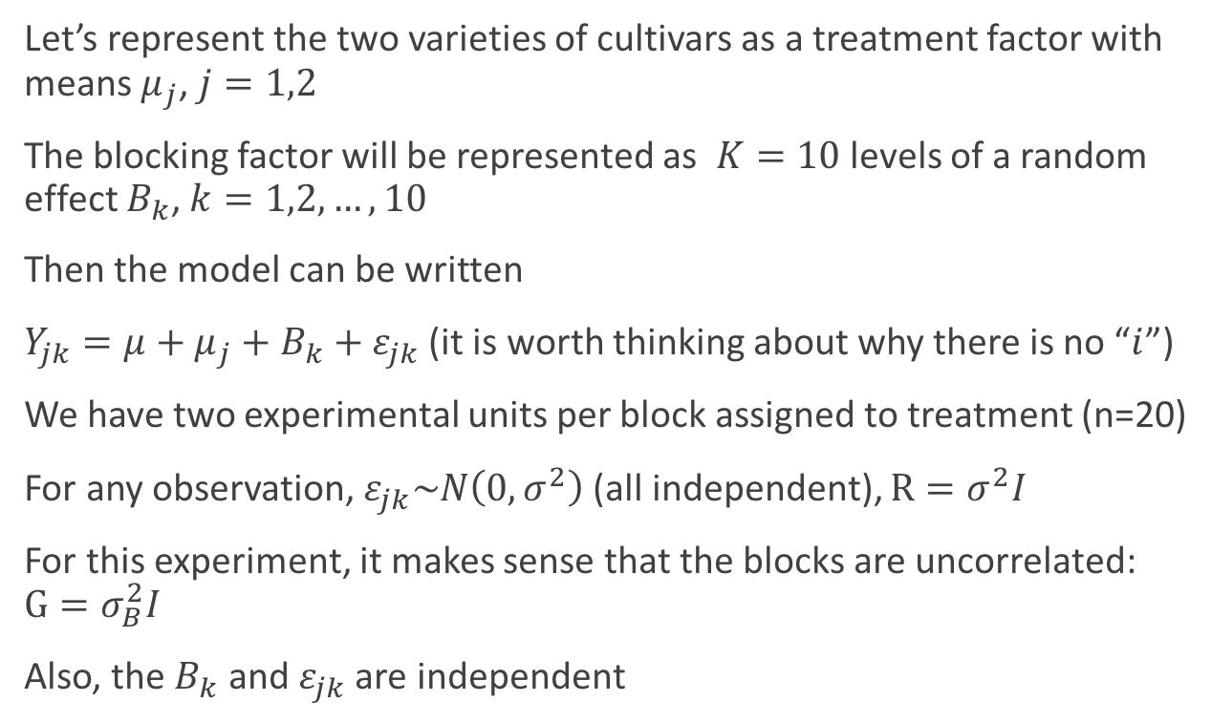
Testing for Treatment Effect with a Blocked Design
Let’s represent the two varieties of cultivars as a treatment factor with means $μ_{j}$, $j=1,2$
The blocking factor will be represented as $K=10$ levels of a random effect $B_{k}$, $k=1,2,…,10$
Then the model can be written
$Y_{jk}=μ+μ_{j}+B_{k}+ε_{jk}$ (it is worth thinking about why there is no “$i$”)
We have two experimental units per block assigned to treatment (n=20)
For any observation, $ε_{jk}\sim N\left(0,σ^{2}\right)$ (all independent), $R=σ^{2}I$
For this experiment, it makes sense that the blocks are uncorrelated: $G=σ_{B}^{2}I$
Also, the $B_{k}$ and $ε_{jk}$ are independent

Slide 22
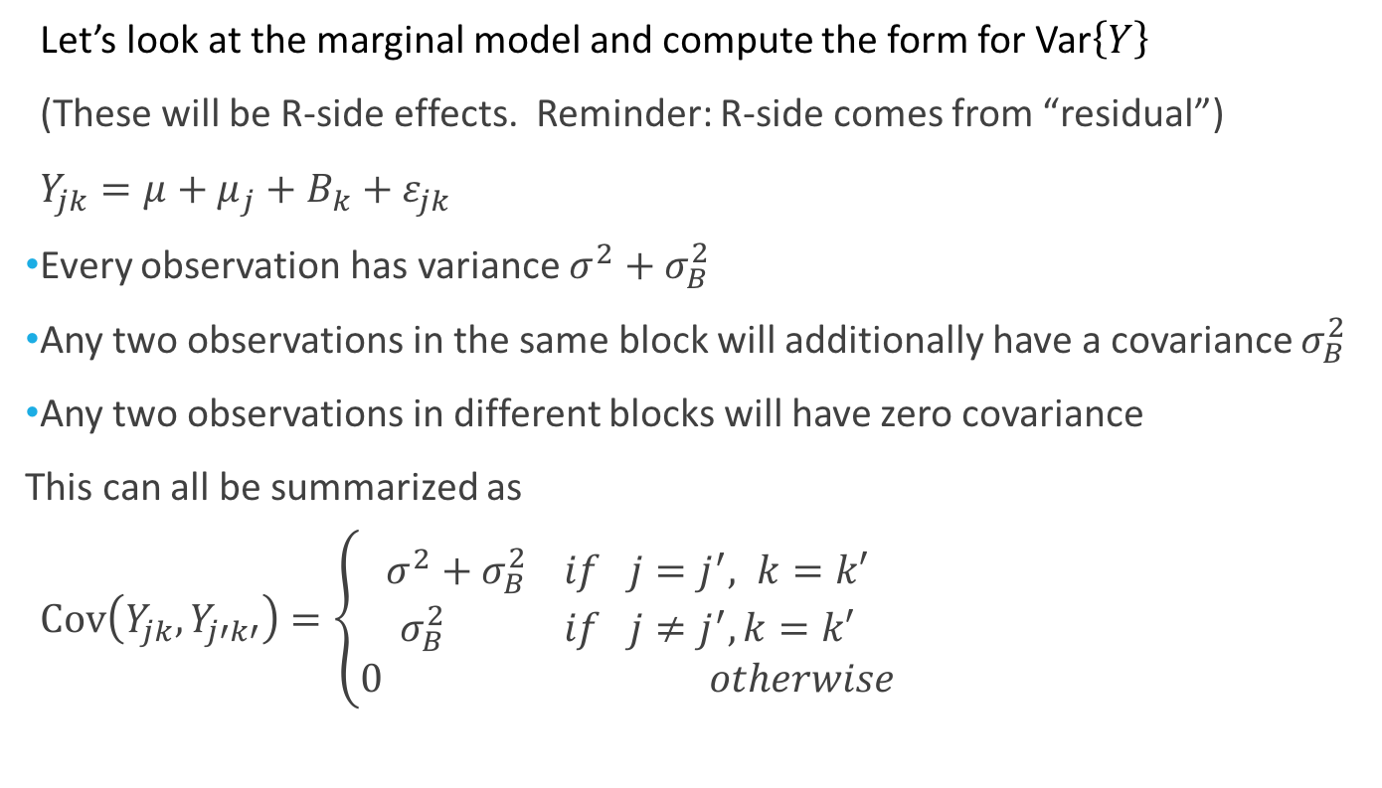
Testing for Treatment Effect with a Blocked Design
Let’s look at the marginal model and compute the form for Var$\left\{Y\right\}$
(These will be R-side effects. Reminder: R-side comes from “residual”)
$Y_{jk}=μ+μ_{j}+B_{k}+ε_{jk}$
Every observation has variance $σ^{2}+σ_{B}^{2}$
Any two observations in the same block will additionally have a covariance $σ_{B}^{2}$
Any two observations in different blocks will have zero covariance
This can all be summarized as
$Cov\left(Y_{jk},Y_{j′k′}\right)=\left\{\begin{aligned}σ^{2}+σ_{B}^{2} if j=j^{′}, k=k′ \\ σ_{B}^{2} if j≠j^{′}, k=k′ \\ 0 otherwise\end{aligned}\right.$

Slide 23
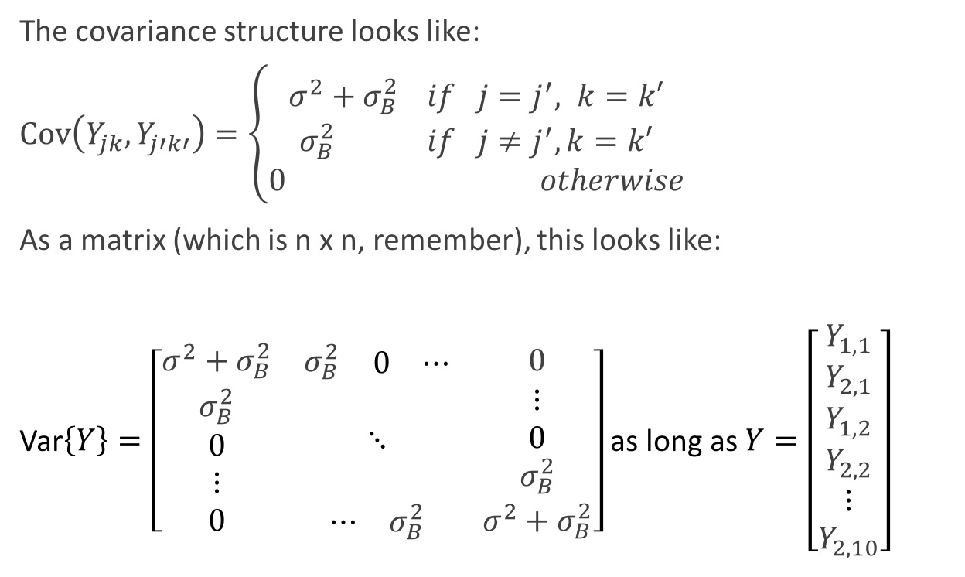
The Marginal Covariance Matrix
The covariance structure looks like:
$Cov\left(Y_{jk},Y_{j′k′}\right)=\left\{\begin{aligned}σ^{2}+σ_{B}^{2} if j=j^{′}, k=k′ \\ σ_{B}^{2} if j≠j^{′}, k=k′ \\ 0 otherwise\end{aligned}\right.$
As a matrix (which is n x n, remember), this looks like:
Var$\left\{Y\right\}=\left[\begin{matrix}σ^{2}+σ_{B}^{2} & \begin{matrix}σ_{B}^{2} & \begin{matrix}0 & ⋯\end{matrix}\end{matrix} & 0 \\ \begin{matrix}σ_{B}^{2} \\ 0 \\ ⋮\end{matrix} & ⋱ & \begin{matrix}⋮ \\ 0 \\ σ_{B}^{2}\end{matrix} \\ 0 & \begin{matrix}⋯ & σ_{B}^{2}\end{matrix} & σ^{2}+σ_{B}^{2}\end{matrix}\right]$ as long as $Y=\left[\begin{matrix}Y_{1,1} \\ Y_{2,1} \\ \begin{matrix}Y_{1,2} \\ Y_{2,2} \\ \begin{matrix}⋮ \\ Y_{2,10}\end{matrix}\end{matrix}\end{matrix}\right]$

Slide 24
Covariance Structures

Slide 25
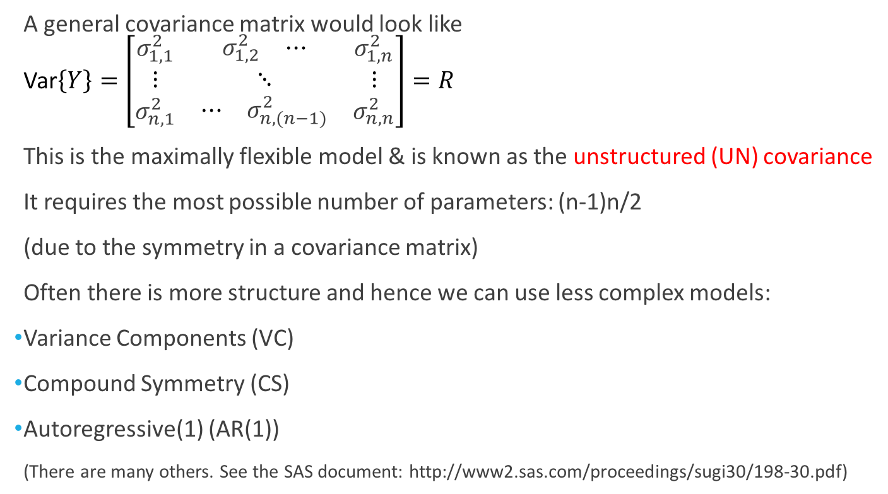
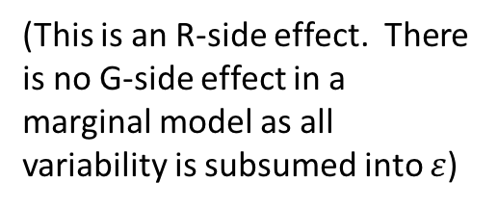
A General Covariance Matrix
A general covariance matrix would look like Var$\left\{Y\right\}=\left[\begin{matrix}σ_{1,1}^{2} & \begin{matrix}σ_{1,2}^{2} & ⋯\end{matrix} & σ_{1,n}^{2} \\ ⋮ & ⋱ & ⋮ \\ σ_{n,1}^{2} & \begin{matrix}⋯ & σ_{n,(n−1)}^{2}\end{matrix} & σ_{n,n}^{2}\end{matrix}\right]=R$
This is the maximally flexible model & is known as the unstructured (UN) covariance
It requires the most possible number of parameters: (n-1)n/2
(due to the symmetry in a covariance matrix)
Often there is more structure and hence we can use less complex models:
Variance Components (VC)
Compound Symmetry (CS)
Autoregressive(1) (AR(1))
(There are many others. See the SAS document: http://www2.sas.com/proceedings/sugi30/198-30.pdf)
(This is an R-side effect. There is no G-side effect in a marginal model as all variability is subsumed into $ε$)

Slide 26
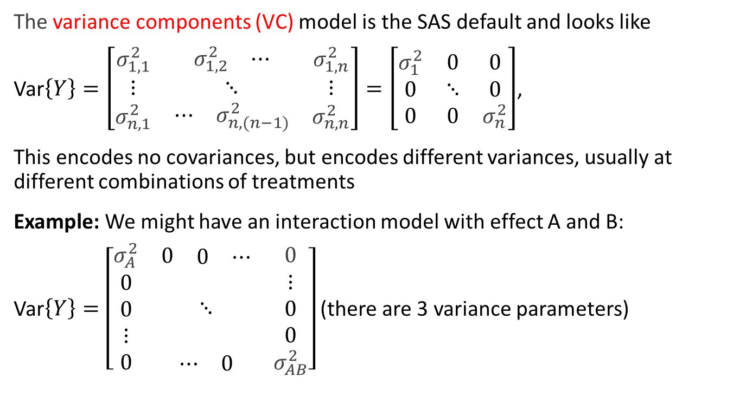
Variance Components
The variance components (VC) model is the SAS default and looks like
Var$\left\{Y\right\}=\left[\begin{matrix}σ_{1,1}^{2} & \begin{matrix}σ_{1,2}^{2} & ⋯\end{matrix} & σ_{1,n}^{2} \\ ⋮ & ⋱ & ⋮ \\ σ_{n,1}^{2} & \begin{matrix}⋯ & σ_{n,(n−1)}^{2}\end{matrix} & σ_{n,n}^{2}\end{matrix}\right]=\left[\begin{matrix}σ_{1}^{2} & 0 & 0 \\ 0 & ⋱ & 0 \\ 0 & 0 & σ_{n}^{2}\end{matrix}\right]$,
This encodes no covariances, but encodes different variances, usually at different combinations of treatments
Example: We might have an interaction model with effect A and B:
Var$\left\{Y\right\}=\left[\begin{matrix}σ_{A}^{2} & \begin{matrix}0 & \begin{matrix}0 & ⋯\end{matrix}\end{matrix} & 0 \\ \begin{matrix}0 \\ 0 \\ ⋮\end{matrix} & ⋱ & \begin{matrix}⋮ \\ 0 \\ 0\end{matrix} \\ 0 & \begin{matrix}⋯ & 0\end{matrix} & σ_{AB}^{2}\end{matrix}\right]$ (there are 3 variance parameters)

Slide 27
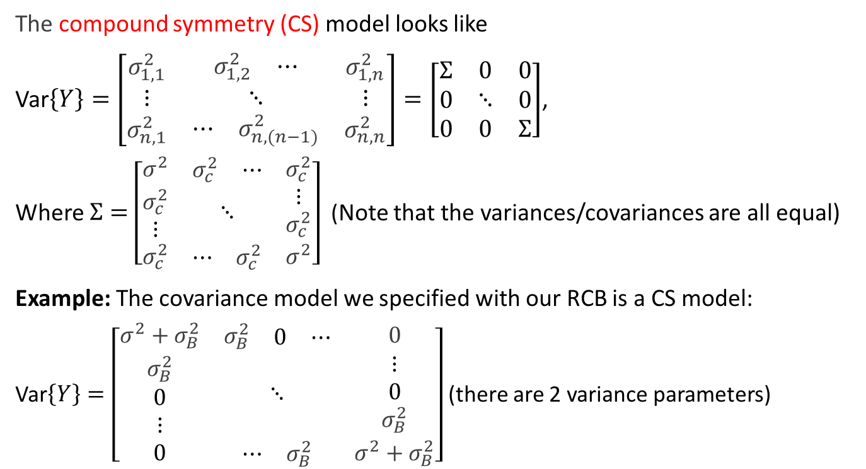
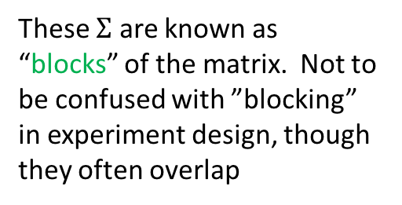
Compound Symmetry
The compound symmetry (CS) model looks like
Var$\left\{Y\right\}=\left[\begin{matrix}σ_{1,1}^{2} & \begin{matrix}σ_{1,2}^{2} & ⋯\end{matrix} & σ_{1,n}^{2} \\ ⋮ & ⋱ & ⋮ \\ σ_{n,1}^{2} & \begin{matrix}⋯ & σ_{n,(n−1)}^{2}\end{matrix} & σ_{n,n}^{2}\end{matrix}\right]=\left[\begin{matrix}Σ & 0 & 0 \\ 0 & ⋱ & 0 \\ 0 & 0 & Σ\end{matrix}\right]$,
Where $Σ=$ $\left[\begin{matrix}σ^{2} & \begin{matrix}σ_{c}^{2} & ⋯\end{matrix} & σ_{c}^{2} \\ \begin{matrix}σ_{c}^{2} \\ ⋮\end{matrix} & ⋱ & \begin{matrix}⋮ \\ σ_{c}^{2}\end{matrix} \\ σ_{c}^{2} & \begin{matrix}⋯ & σ_{c}^{2}\end{matrix} & σ^{2}\end{matrix}\right]$ (Note that the variances/covariances are all equal)
Example: The covariance model we specified with our RCB is a CS model:
Var$\left\{Y\right\}=\left[\begin{matrix}σ^{2}+σ_{B}^{2} & \begin{matrix}σ_{B}^{2} & \begin{matrix}0 & ⋯\end{matrix}\end{matrix} & 0 \\ \begin{matrix}σ_{B}^{2} \\ 0 \\ ⋮\end{matrix} & ⋱ & \begin{matrix}⋮ \\ 0 \\ σ_{B}^{2}\end{matrix} \\ 0 & \begin{matrix}⋯ & σ_{B}^{2}\end{matrix} & σ^{2}+σ_{B}^{2}\end{matrix}\right]$ (there are 2 variance parameters)
These $Σ$ are known as “blocks” of the matrix. Not to be confused with ”blocking” in experiment design, though they often overlap

Slide 28
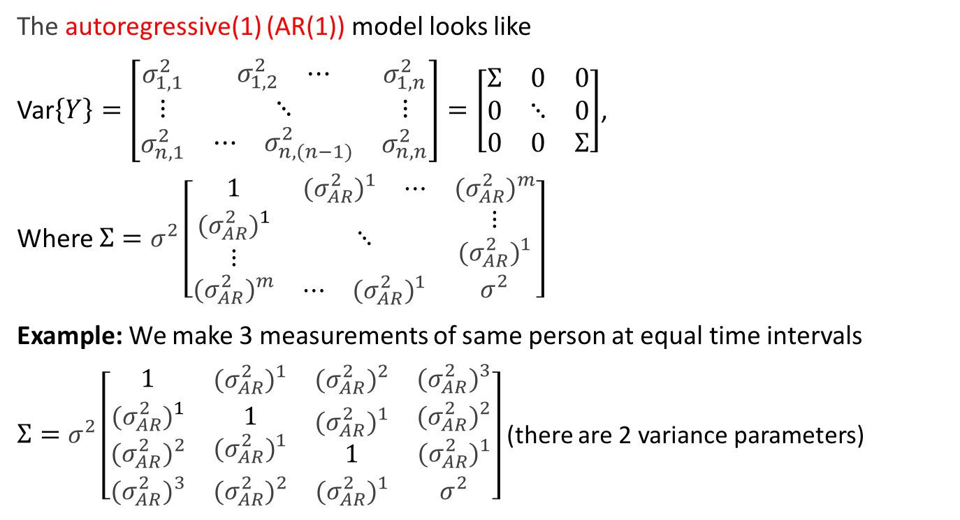
Autoregressive (1)
(We will return to AR(1) with time series and with repeated measures)
The autoregressive(1) (AR(1)) model looks like
Var$\left\{Y\right\}=\left[\begin{matrix}σ_{1,1}^{2} & \begin{matrix}σ_{1,2}^{2} & ⋯\end{matrix} & σ_{1,n}^{2} \\ ⋮ & ⋱ & ⋮ \\ σ_{n,1}^{2} & \begin{matrix}⋯ & σ_{n,(n−1)}^{2}\end{matrix} & σ_{n,n}^{2}\end{matrix}\right]=\left[\begin{matrix}Σ & 0 & 0 \\ 0 & ⋱ & 0 \\ 0 & 0 & Σ\end{matrix}\right]$,
Where $Σ=σ^{2}\left[\begin{matrix}1 & \begin{matrix}{{(σ}_{AR}^{2})}^{1} & ⋯\end{matrix} & {{(σ}_{AR}^{2})}^{m} \\ \begin{matrix}{{(σ}_{AR}^{2})}^{1} \\ ⋮\end{matrix} & ⋱ & \begin{matrix}⋮ \\ {{(σ}_{AR}^{2})}^{1}\end{matrix} \\ {{(σ}_{AR}^{2})}^{m} & \begin{matrix}⋯ & {{(σ}_{AR}^{2})}^{1}\end{matrix} & σ^{2}\end{matrix}\right]$
Example: We make 3 measurements of same person at equal time intervals
$Σ=σ^{2}\left[\begin{matrix}1 & \begin{matrix}{{(σ}_{AR}^{2})}^{1} & {{(σ}_{AR}^{2})}^{2}\end{matrix} & {{(σ}_{AR}^{2})}^{3} \\ \begin{matrix}{{(σ}_{AR}^{2})}^{1} \\ {{(σ}_{AR}^{2})}^{2}\end{matrix} & \begin{matrix}\begin{matrix}1 \\ {{(σ}_{AR}^{2})}^{1}\end{matrix} & \begin{matrix}{{(σ}_{AR}^{2})}^{1} \\ 1\end{matrix}\end{matrix} & \begin{matrix}{{(σ}_{AR}^{2})}^{2} \\ {{(σ}_{AR}^{2})}^{1}\end{matrix} \\ {{(σ}_{AR}^{2})}^{3} & \begin{matrix}{{(σ}_{AR}^{2})}^{2} & {{(σ}_{AR}^{2})}^{1}\end{matrix} & σ^{2}\end{matrix}\right]$ (there are 2 variance parameters)

Slide 29
Back to the Example

Slide 30
Reminder of Our Model
Let’s look at the marginal model and compute the form for Var$\left\{Y\right\}$
(These will be R-side effects. Reminder: R-side comes from “residual”)
$Y_{jk}=μ+μ_{j}+B_{k}+ε_{jk}$
Every observation has variance $σ^{2}+σ_{B}^{2}$
Any two observations in the same block will additionally have a covariance $σ_{B}^{2}$
Any two observations in different blocks will have zero covariance
This can all be summarized as
$Cov\left(Y_{jk},Y_{j′k′}\right)=\left\{\begin{aligned}σ^{2}+σ_{B}^{2} if j=j^{′}, k=k′ \\ σ_{B}^{2} if j≠j^{′}, k=k′ \\ 0 otherwise\end{aligned}\right.$

Slide 31
Using SAS to Analyze Mixed Models
Like usual there are (at least) two main ways to analyze mixed models in SAS
Proc Glimmix
Proc Mixed
Within each procedure, there are many ways of specifying an equivalent model
(e.g. Conditional or Marginal)
Though these specify the equivalent models, that doesn’t mean they are the same!
We will focus on Proc Glimmix for now
Let’s look at this in our current example…

Slide 32
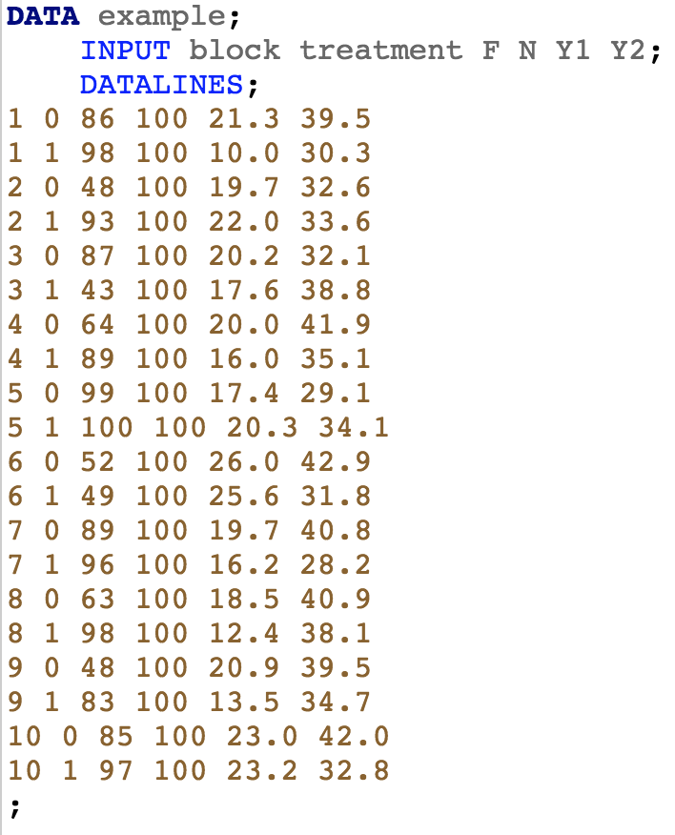
The Data
Here, we are interested in the block, treatment, and Y1 columns

Slide 33
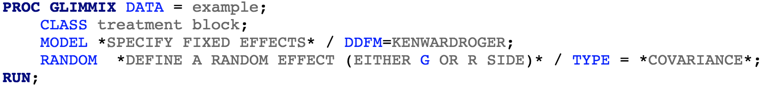
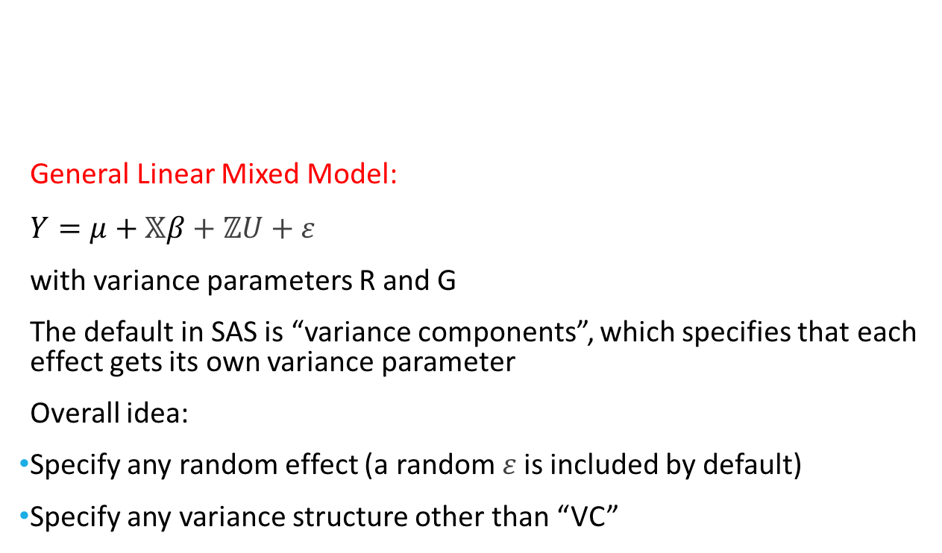
PROC GLIMMIX
This is a DF approximation. You should use it (I won’t always in the code for simplicity, however)
General Linear Mixed Model:
$Y=μ+𝕏β+ℤU+ε$
with variance parameters R and G
The default in SAS is “variance components”, which specifies that each effect gets its own variance parameter
Overall idea:
Specify any random effect (a random $ε$is included by default)
Specify any variance structure other than “VC”
(You can specify multiple random statements for different random effects)

Slide 34
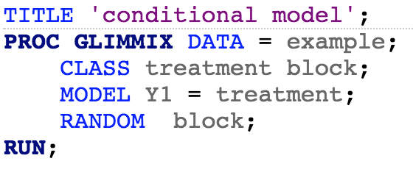
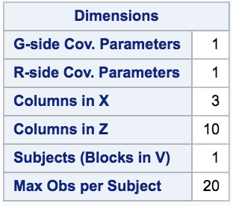
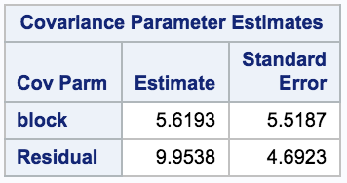
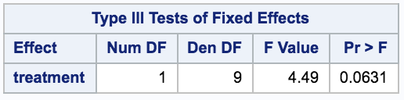
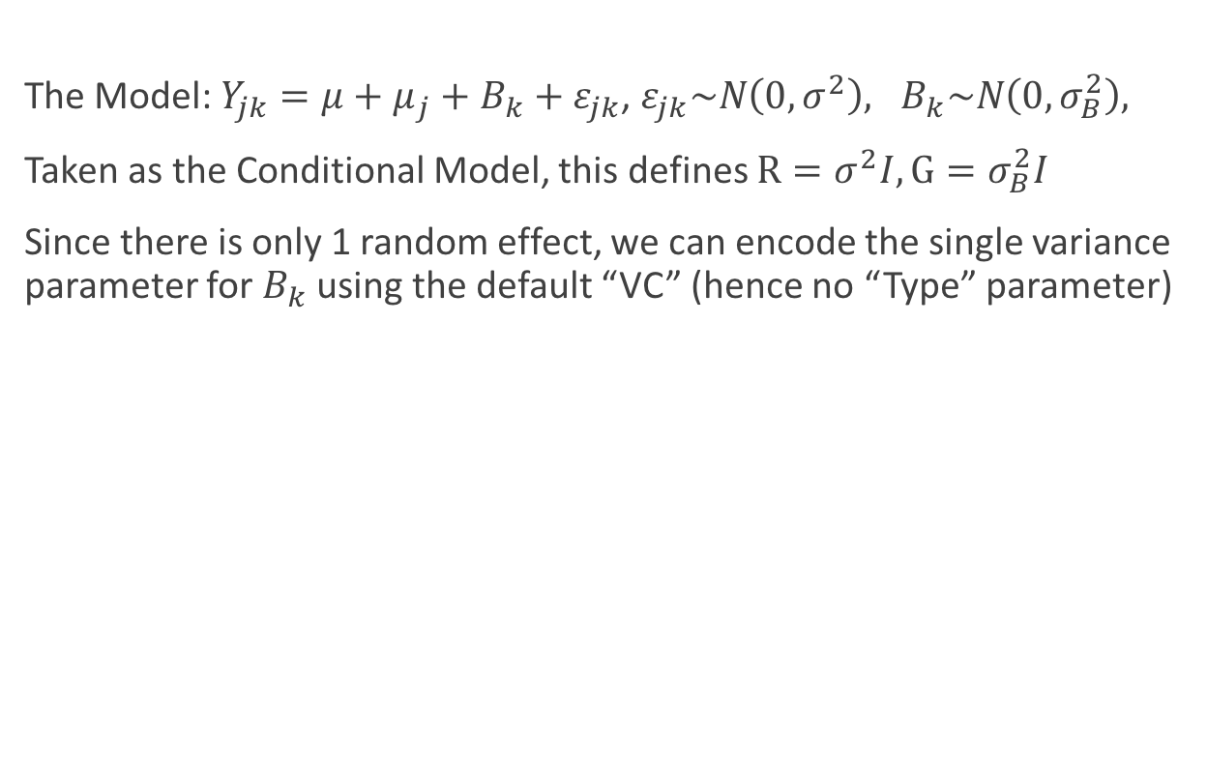

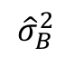
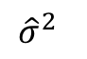
PROC GLIMMIX: Example
“blocks”
The Model: $Y_{jk}=μ+μ_{j}+B_{k}+ε_{jk}$, $ε_{jk}\sim N\left(0,σ^{2}\right), B_{k}\sim N\left(0,σ_{B}^{2}\right),$
Taken as the Conditional Model, this defines $R=σ^{2}I,G=σ_{B}^{2}I$
Since there is only 1 random effect, we can encode the single variance parameter for $B_{k}$ using the default “VC” (hence no “Type” parameter)
$${\hat{σ}}_{B}^{2}$$
$${\hat{σ}}^{2}$$
The treatment is a fixed effect
We are treating block as random. No covariance is specified as VC is the default
$$H_{0}:μ_{1}=μ_{2}$$

Slide 35
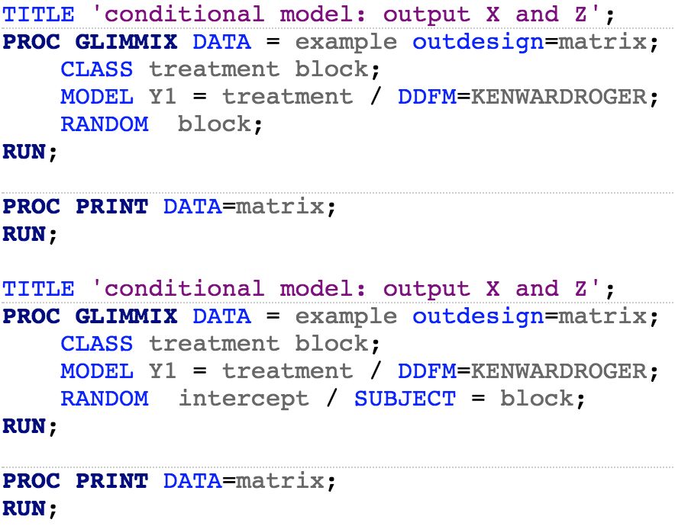
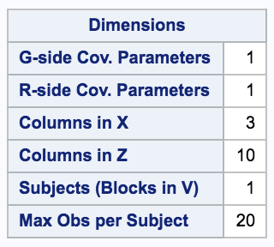
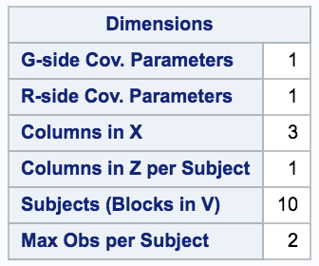
PROC GLIMMIX: Example
Recall that we can think about the covariance matrix in terms of “blocks”
The “blocks” of the covariance matrix get specified via the “SUBJECT” statement
The random effect is an adjustment to the intercept

Slide 36
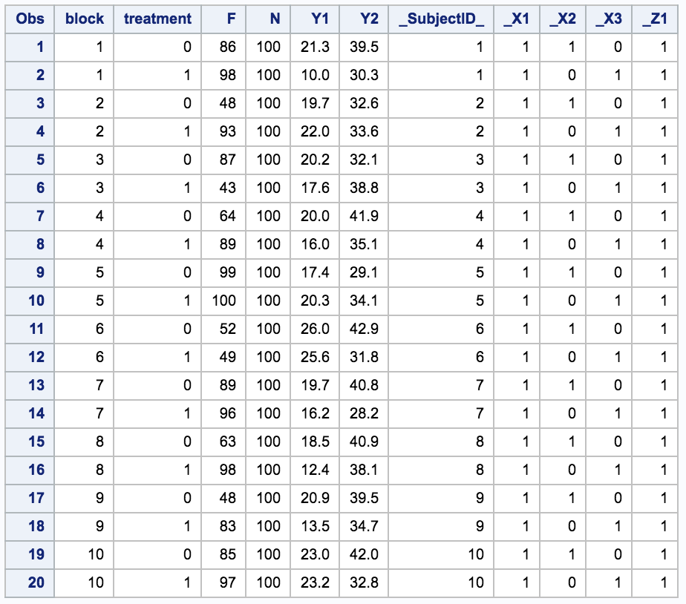
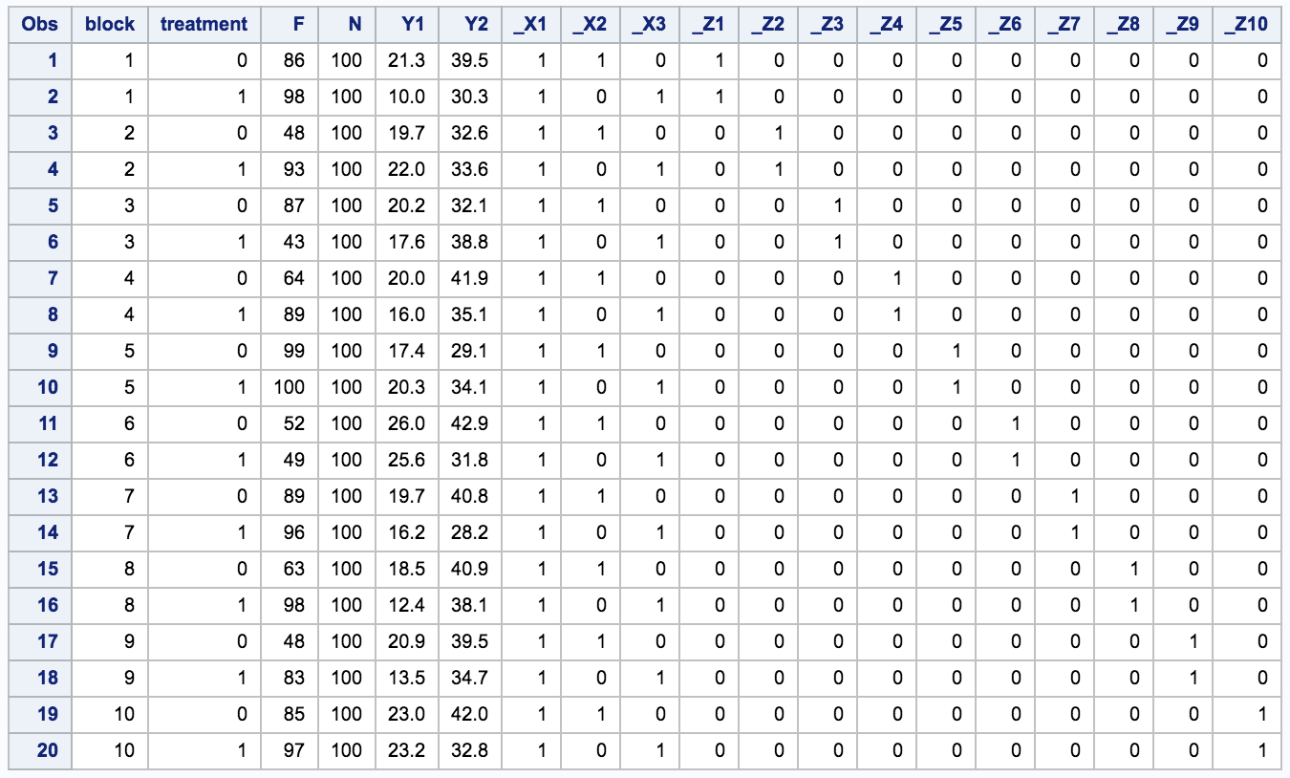
PROC GLIMMIX: Example

Slide 37
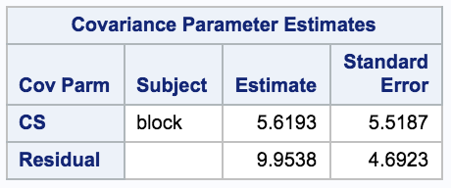
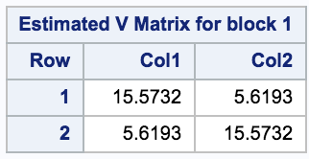
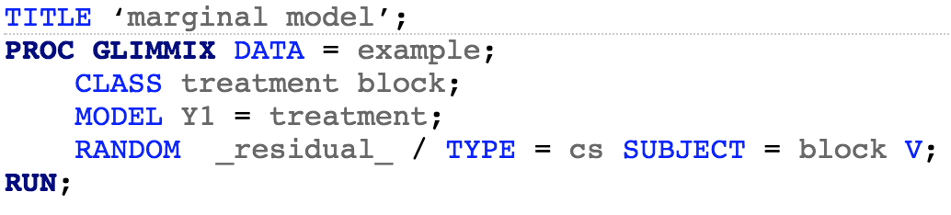
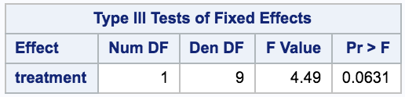
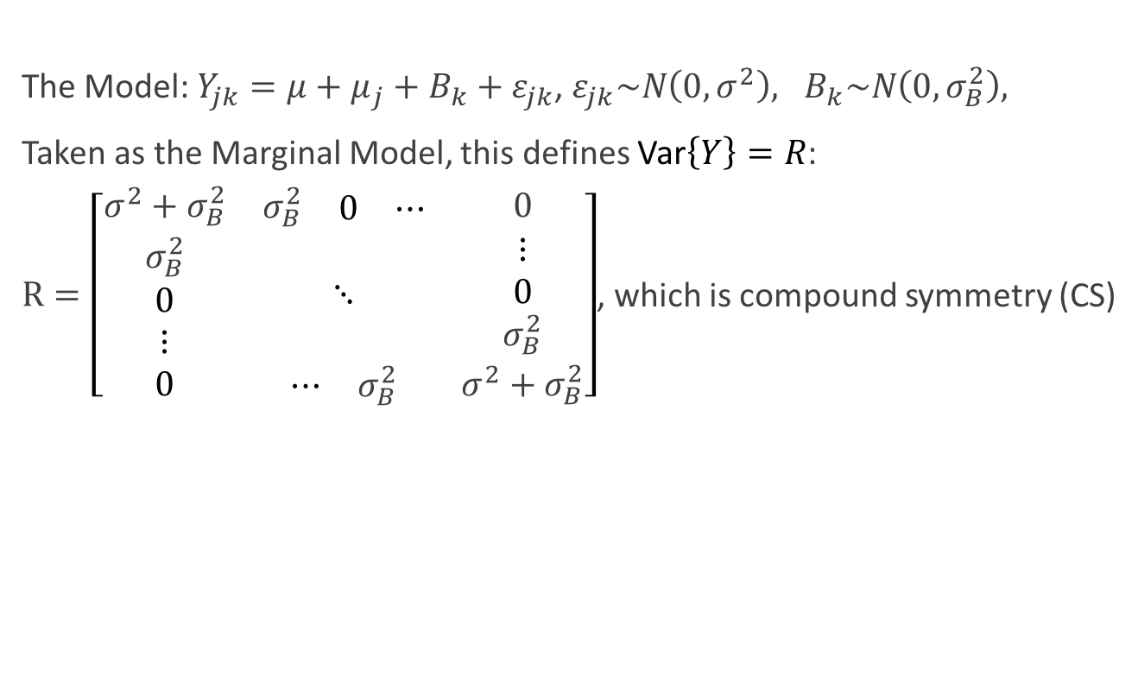
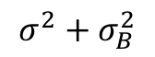

PROC GLIMMIX: Example
The Model: $Y_{jk}=μ+μ_{j}+B_{k}+ε_{jk}$, $ε_{jk}\sim N\left(0,σ^{2}\right), B_{k}\sim N\left(0,σ_{B}^{2}\right),$
Taken as the Marginal Model, this defines Var$\left\{Y\right\}=R$:
$R=\left[\begin{matrix}σ^{2}+σ_{B}^{2} & \begin{matrix}σ_{B}^{2} & \begin{matrix}0 & ⋯\end{matrix}\end{matrix} & 0 \\ \begin{matrix}σ_{B}^{2} \\ 0 \\ ⋮\end{matrix} & ⋱ & \begin{matrix}⋮ \\ 0 \\ σ_{B}^{2}\end{matrix} \\ 0 & \begin{matrix}⋯ & σ_{B}^{2}\end{matrix} & σ^{2}+σ_{B}^{2}\end{matrix}\right]$, which is compound symmetry (CS)
$$σ^{2}+σ_{B}^{2}$$
The “blocks” of the covariance matrix get specified via the “SUBJECT” statement
$$H_{0}:μ_{1}=μ_{2}$$

Slide 38
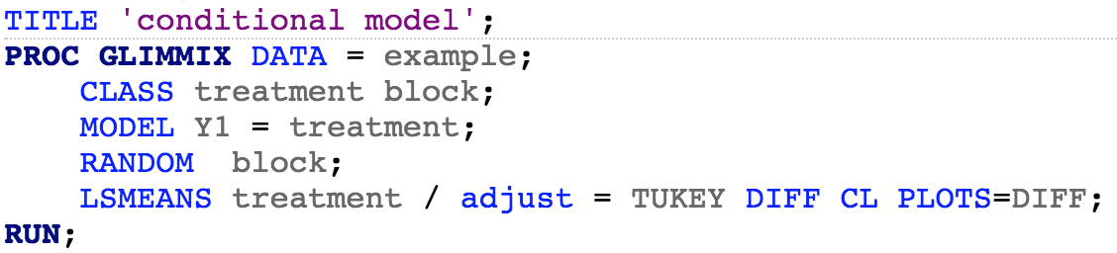
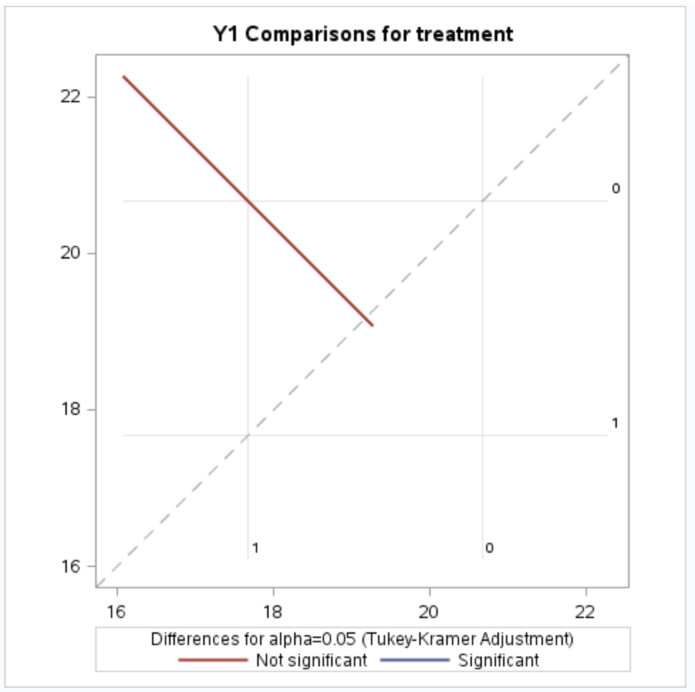
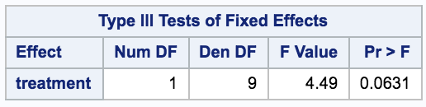
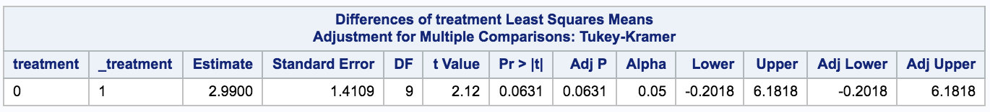
PROC GLIMMIX: Estimating the Treatment Effect
This isn’t needed in this problem. Why?
(These have the same information but it is displayed differently)

Slide 39
When Conditional vs. Marginal Matters

Slide 40
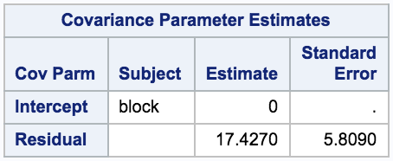





When Conditional vs. Marginal Matters
Notice that there is a zero variance estimate
The REML solution in the conditional model yields a negative variance, which gets thresholded at 0 (this occurs when the MS(block) < MS(error)
If you use the “nobound” option, you will get the same inference in both models but a negative variance in the conditional model

